Slide 1

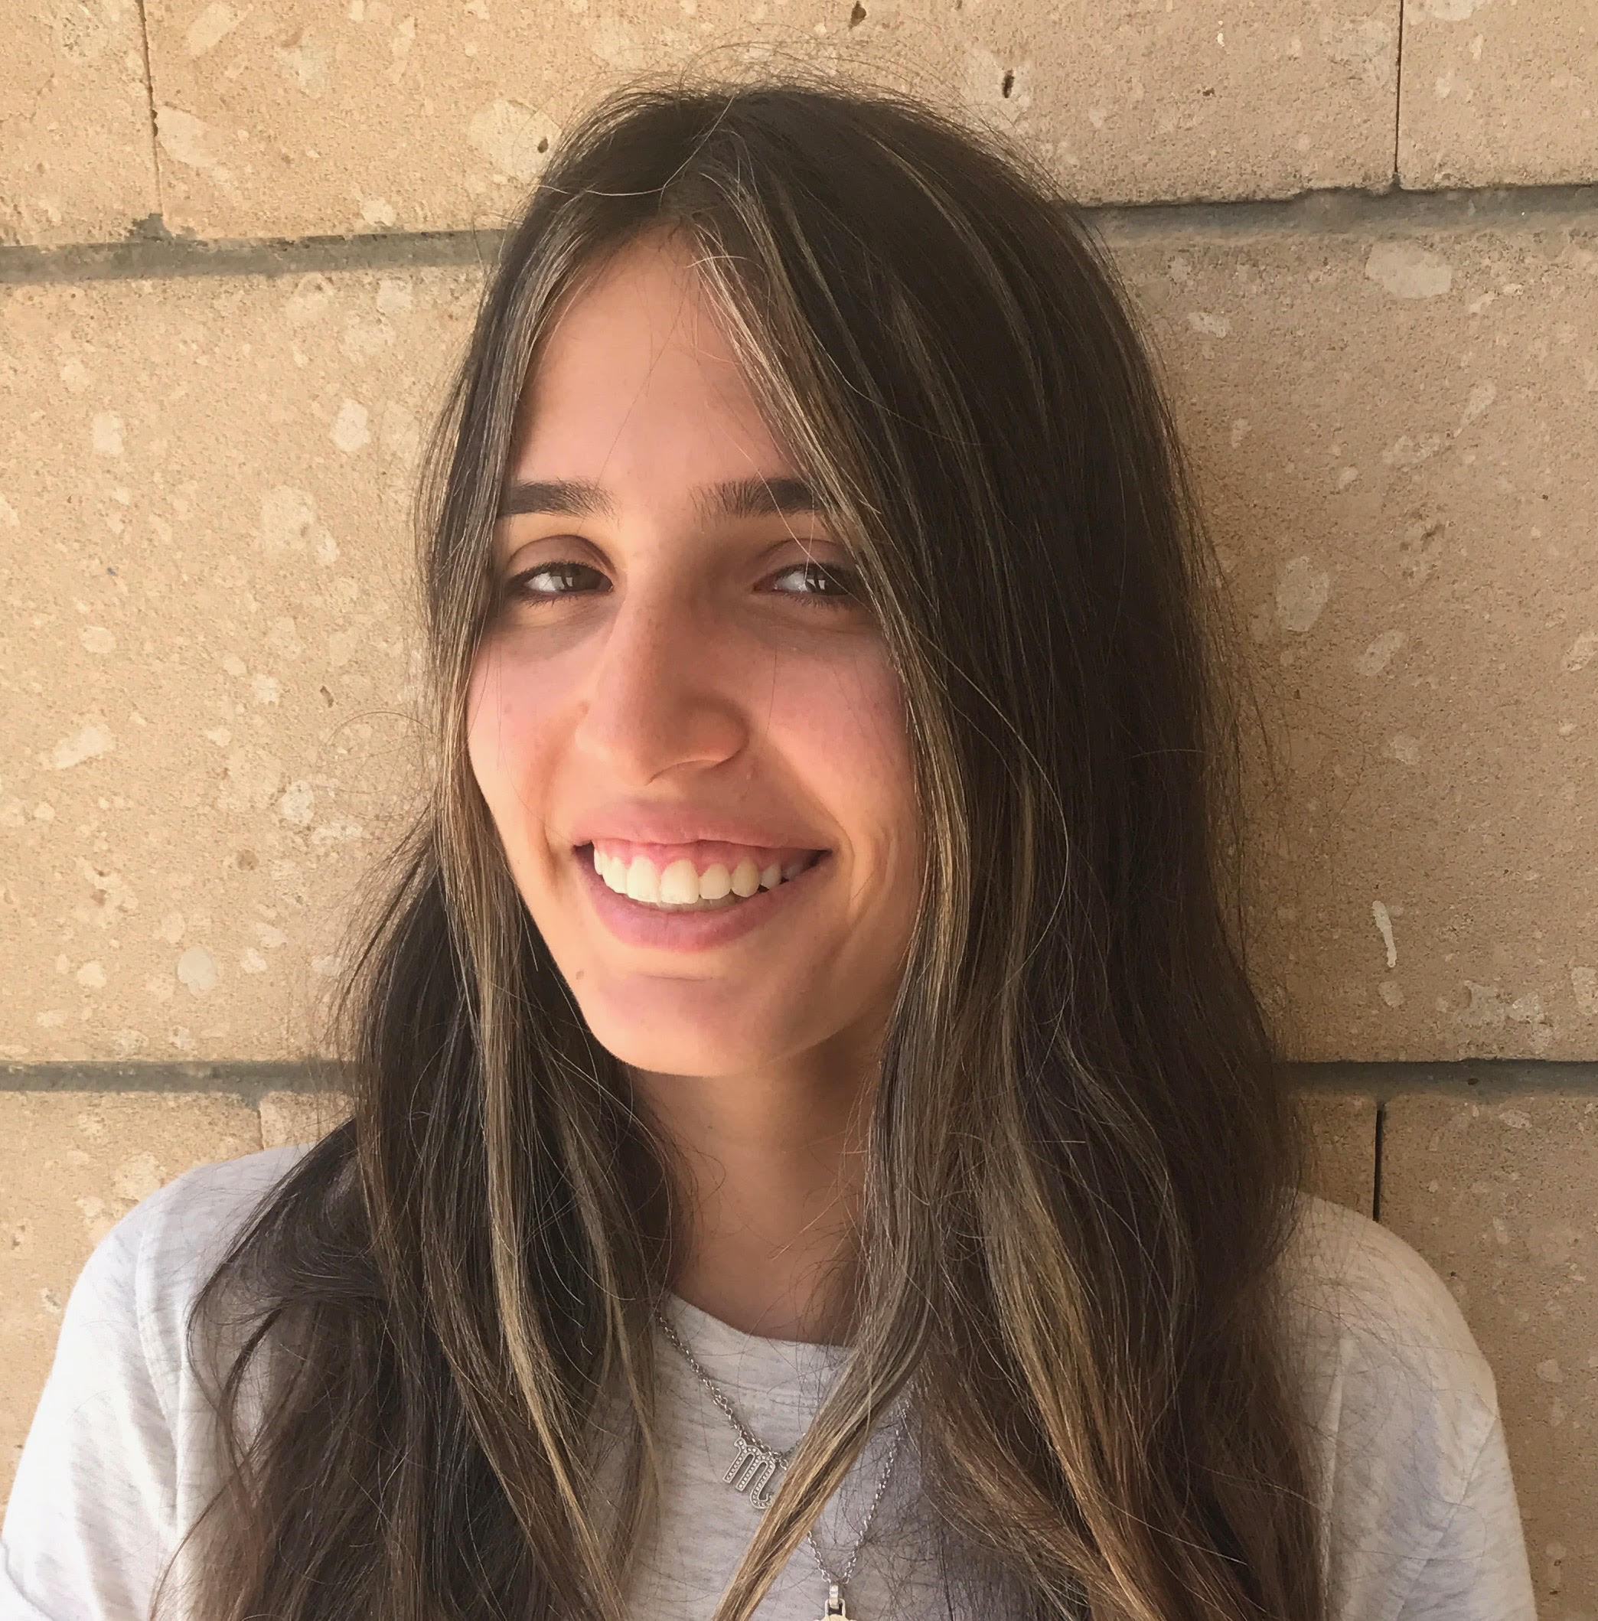
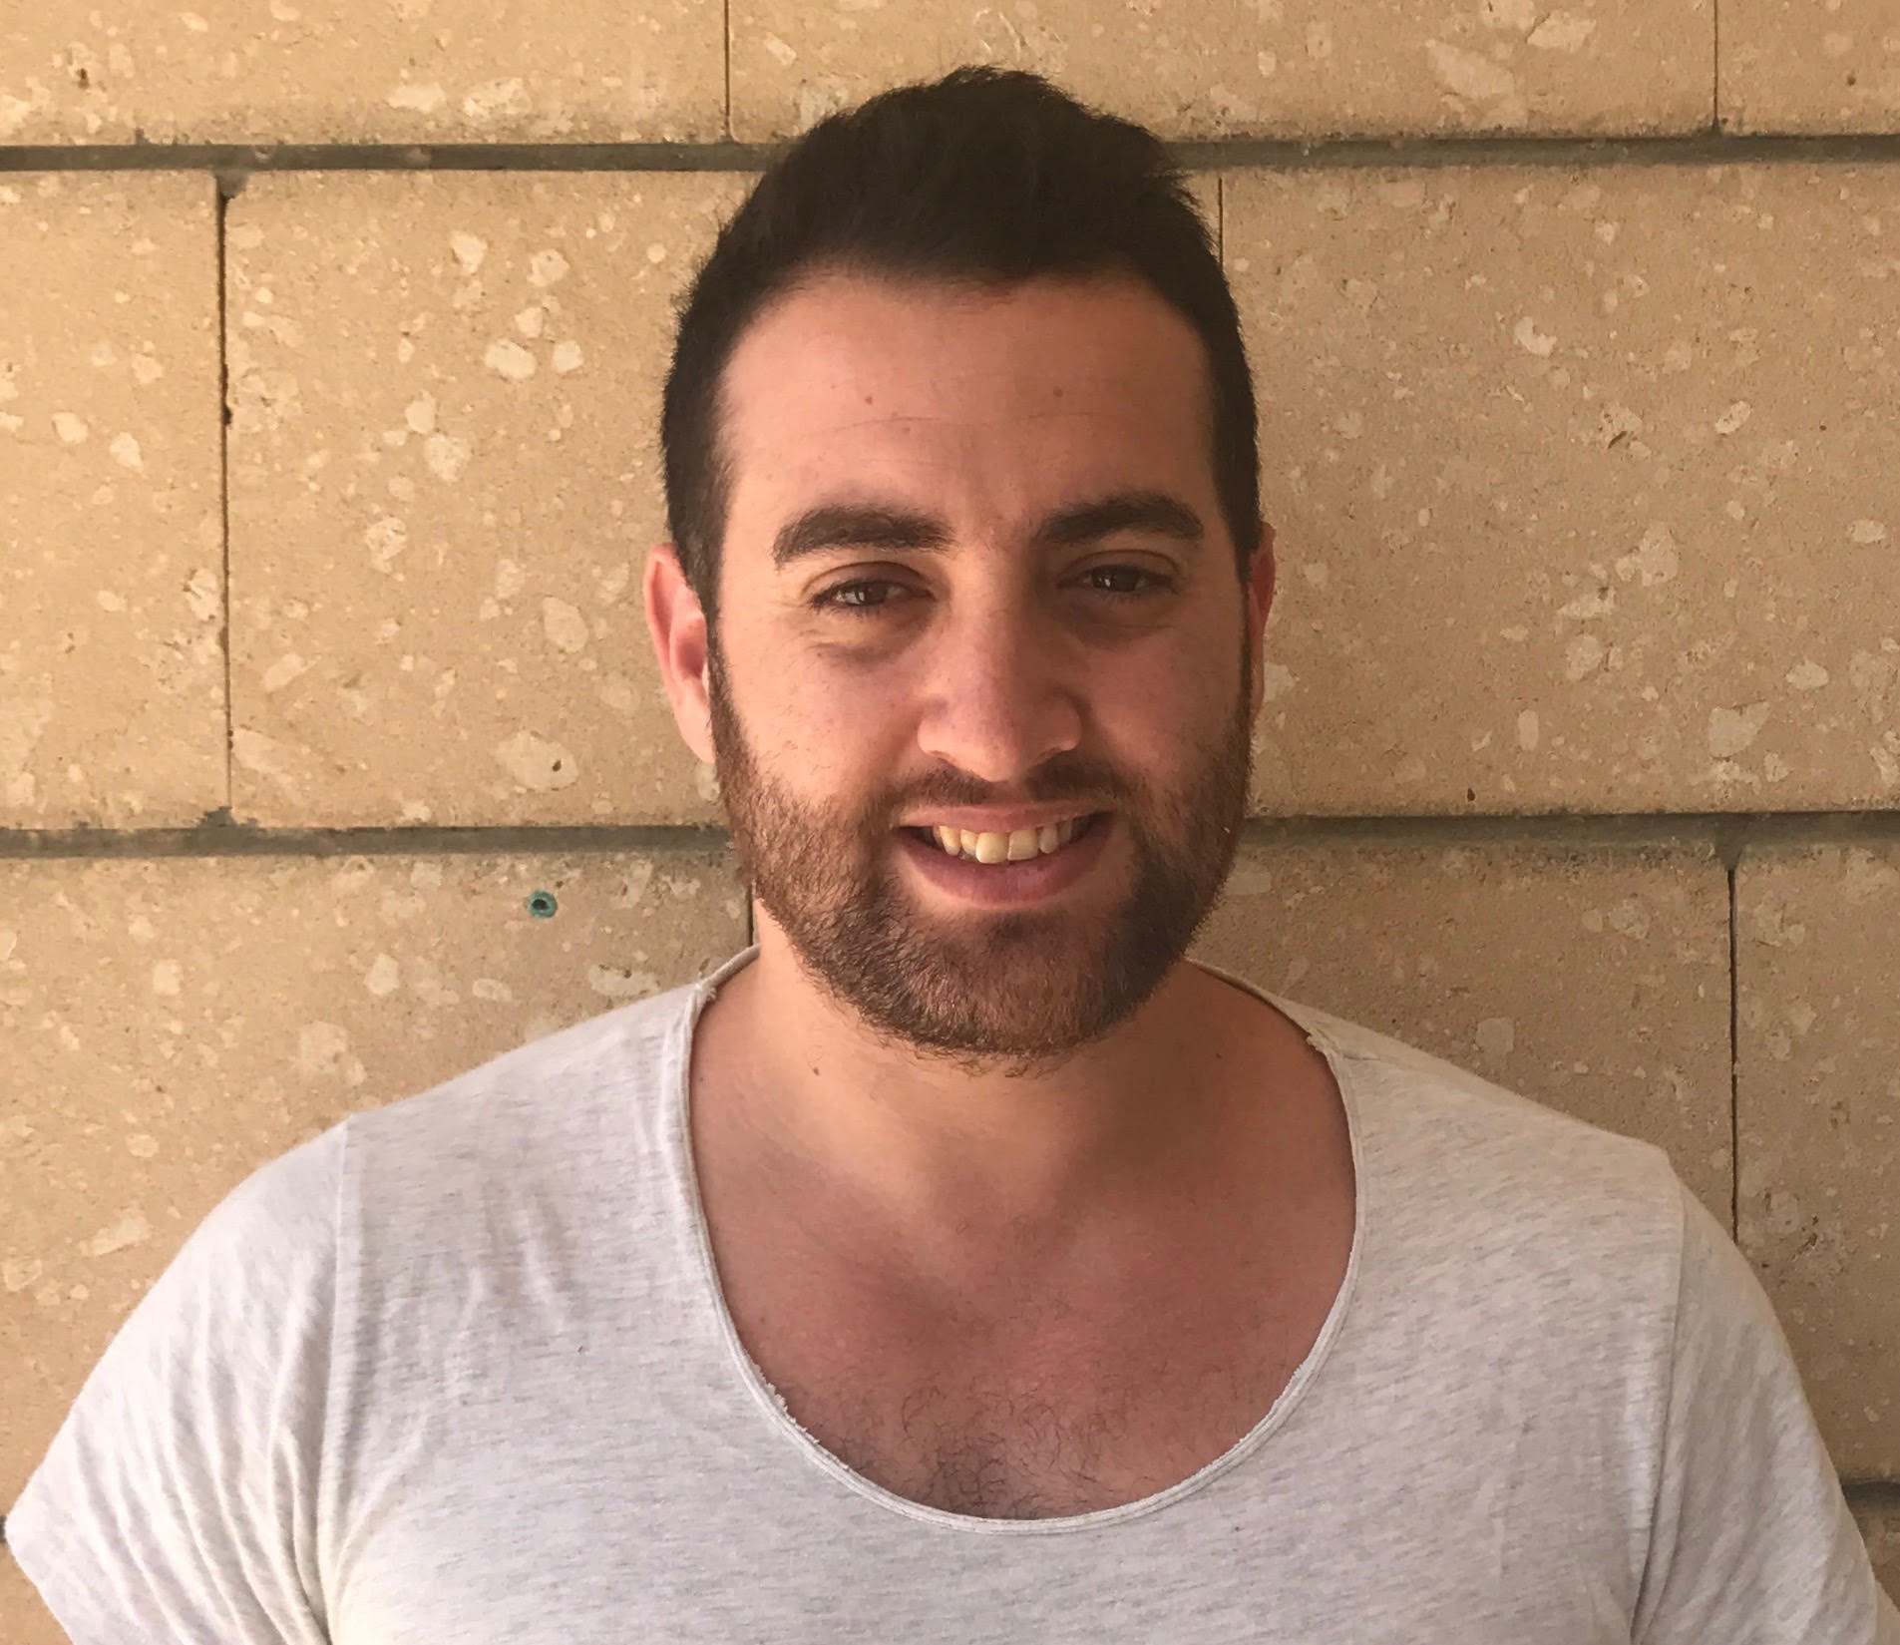
Paz Saban
Idan Davidi
Instructor : Dr Amit Benbassat

Slide 2


Problem

Slide 3
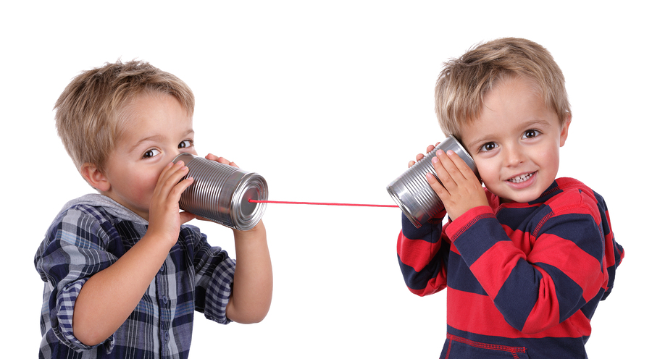
Solution
Lip reading system.
An additional platform for communication for mute and hearing impaired people.
A new way to integrate into society.

Slide 4
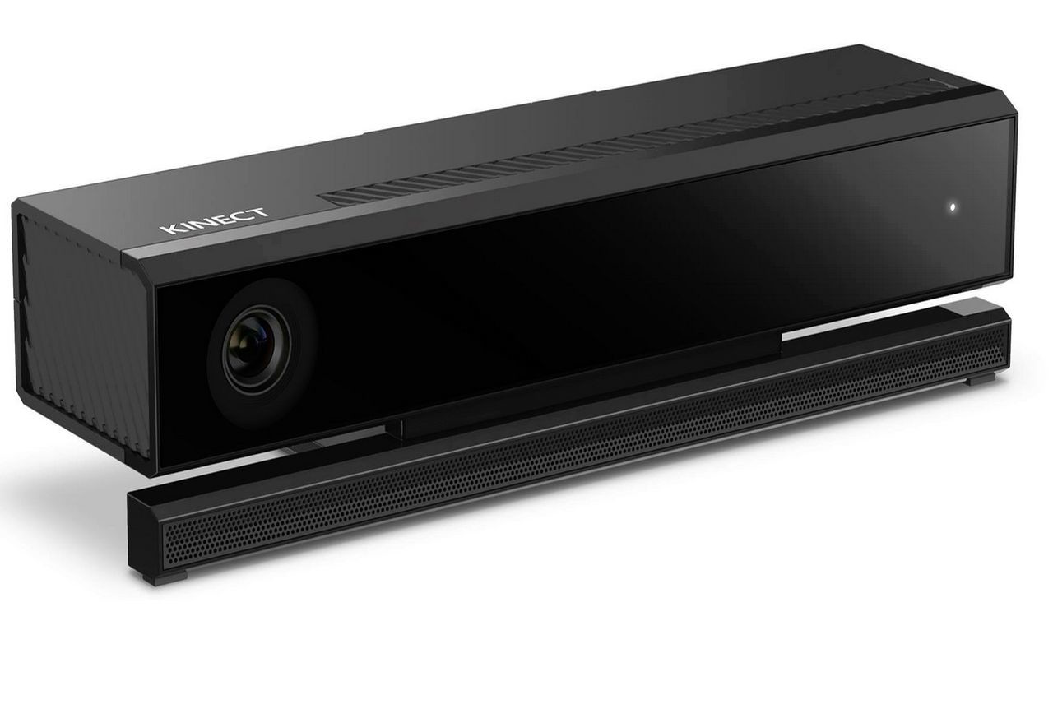

System Description
Read my lips
1

Slide 5
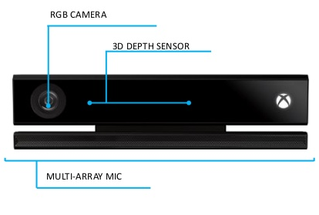
1
Why Kinect?

Slide 6

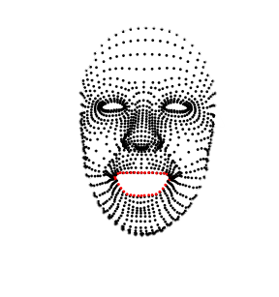
System Description
2
Read my lips
1

Slide 7
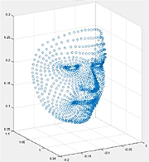
2
A normalization process:
3 base points (nose , right ear , left ear).
Euclidean distances from each point on the lips to the 3 base points.
A list store the data.

Slide 8

System Description
3
2
Read my lips
1

Slide 9
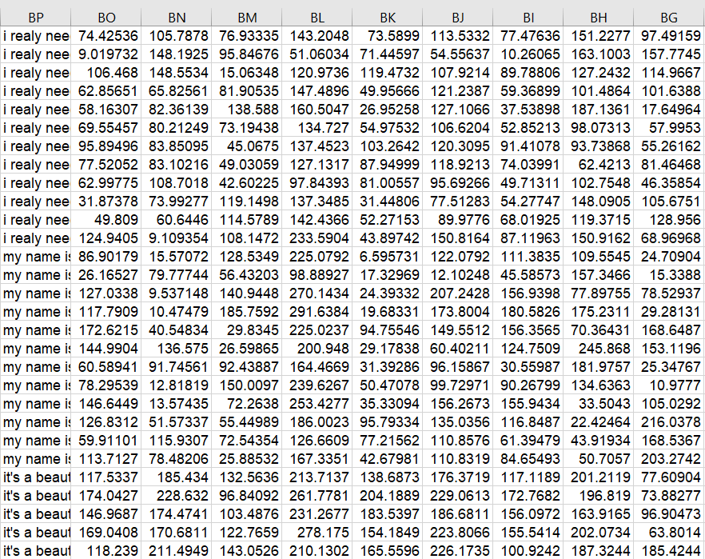
3
Data set
.
.
.

Slide 10
3
Prediction

Slide 11

System Description
3
2
4
Read my lips
1

Slide 12
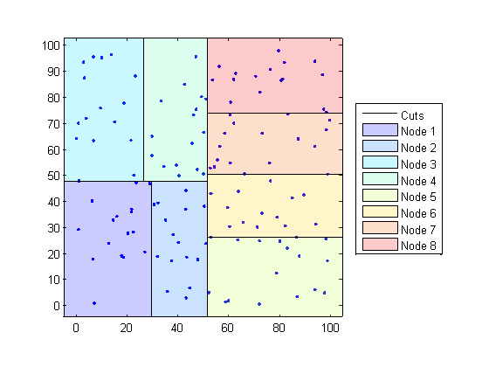
4
KNN algorithm
“where are you my friend?”
“it’s a beautiful day”
“my name is bob”
“I really need help”
“oops I did it again”
“hello ,how are you?”
“what time is it?”
“I’m not your toy”

Slide 13
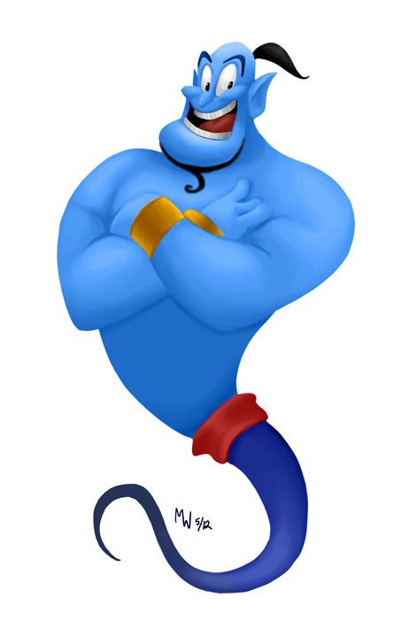
System Description
3
2
4
Read my lips
1
5

Slide 14
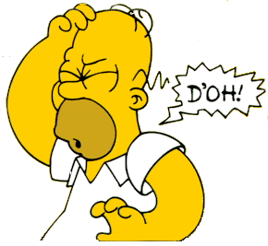
difficulties
Learning new programming languages.
Manage the Kinect’s functionality.
Make the data more accurate.

Slide 15





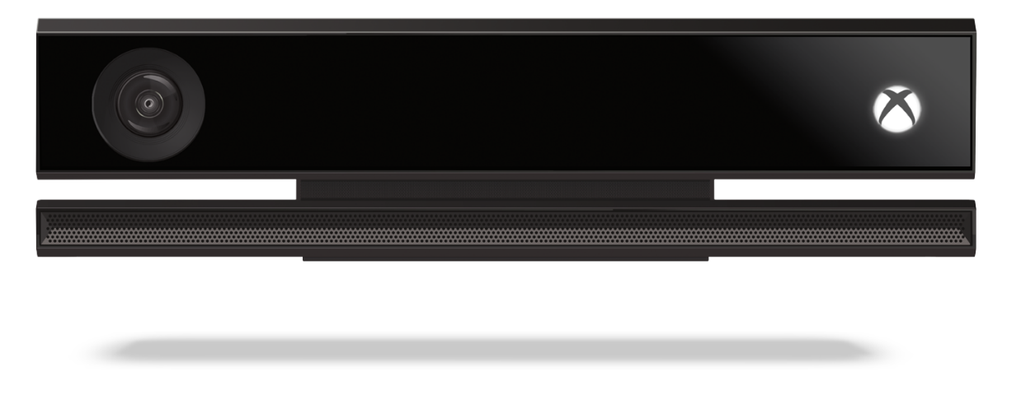
Technological means

Slide 16




Market survey
description
Input data
comfort
Self-learning
Speech recognition
Dimensional mapping
Community help
mobility
cost
Read my lips | Verity-facial lie detector | Silent speech interfaces
Speech recognition without voice | Lye detection app | Silent speech recognition
Speak +face recognition | Video from smartphone camera | speak
free | One time payment | free

Slide 17
What’s next?
Using
smartphone camera
Support more languages
04
Not only
sentences
03
Larger
dictionary
02
01

Slide 18
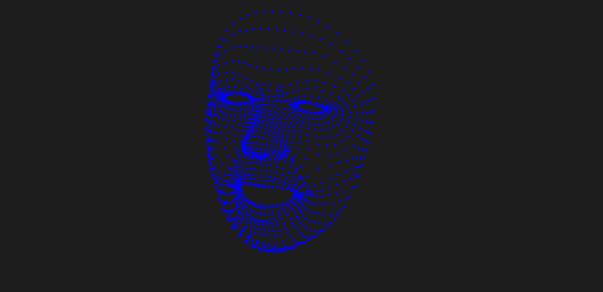
Demonstration
“where are you my friend?”
“it’s a beautiful day”
“my name is bob”
“I really need help”
“oops I did it again”
“hello ,how are you?”
“what time is it?”
“I’m not your toy”

Slide 19

Questions

